Slide 1
Getting Started with Terraform on Azure
Mobin Daraie – Cloud Solution Architect – Azure Core

Slide 2






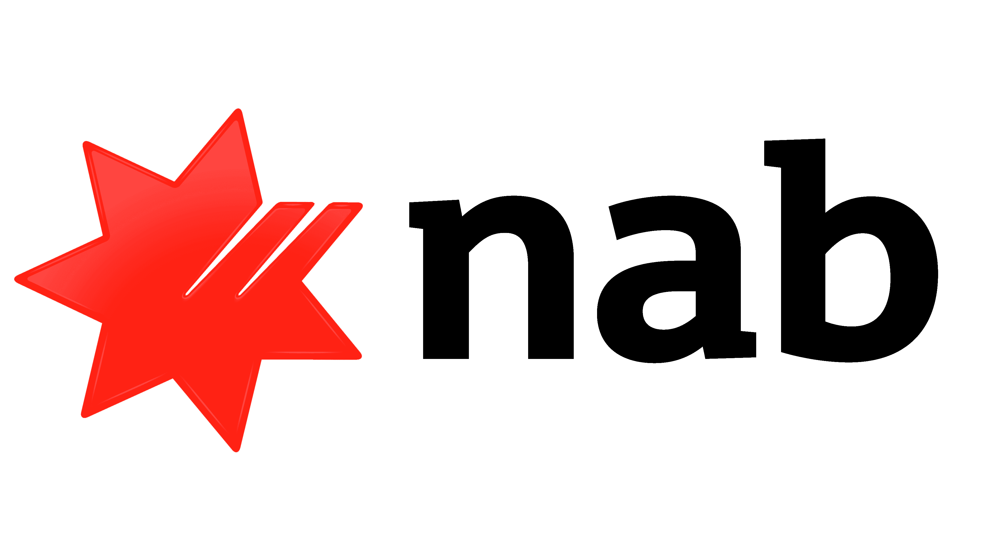
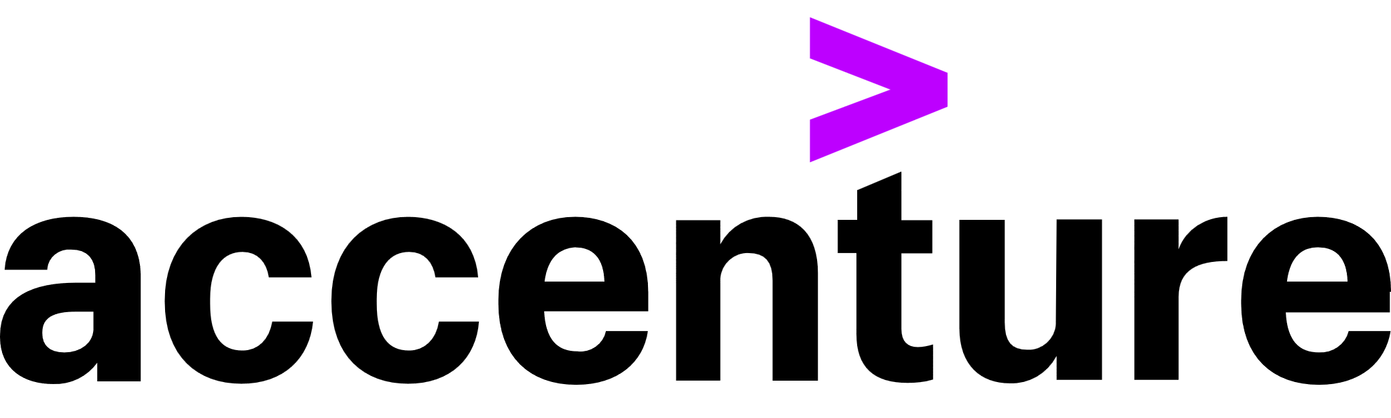

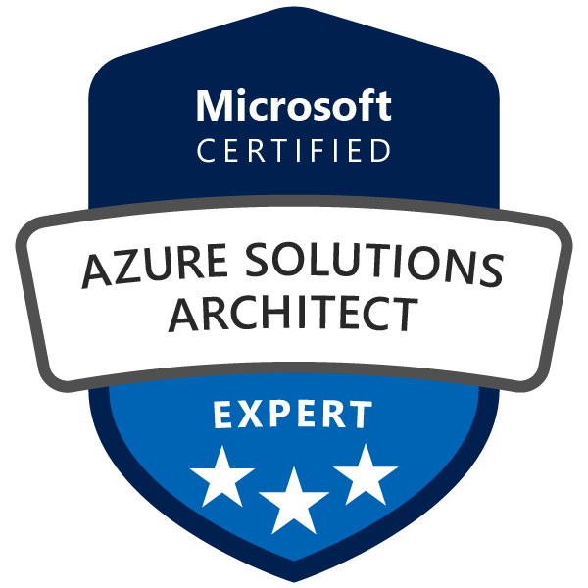
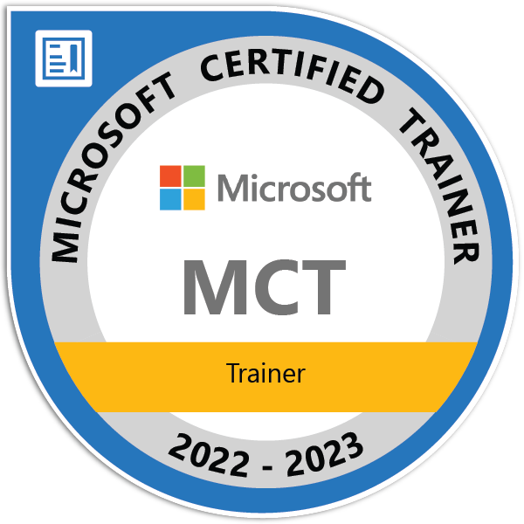

About Me
1
Current Engagement
4
Cloud and Infrastructure Projects:
Infra and Core dedicated CSA - Telstra
Infra CSA: Toll, Asahi, Vic Health
DNS Forwarder/NTP – Azure – AGL
CCRE Migration – AWS – ANZ Bank
HyperConverged Infra – Datacentre - AGL
Cloud Cost Optimisation – Azure - AGL
IAM Uplift – Azure - AGL Energy
CyberArk Migration – Azure – AGL
Axway MFT Migration – Azure – AGL
Azure Virtual Desktop – Azure – AGL
Cloud Identity Strategy – AGL
VMWare on AWS- NAB Bank
AD Legacy Decommission – NAB
DB Insourcing – NAB
Cloud Architecture Patterns – Azure & AWS – AGL and ANZ Bank
Cloud Solution Architect
Telstra
2
Previous Engagements
Associate Director | Financial Services
Cloud Solution Architect
Cloud Transformation
Cloud, Infra and Workplace
OSS/BSS SaaS Implementation
3
Professional Certifications

Slide 3
Agenda
Part I: Theory
Introduction Infrastructure as Code (IaC)
IaC Languages: Imperative vs. Declarative
What is Terraform
Terraform Terminology
Setting Up Environment
Terraform Workflow
Terraform Configuration File
Providers
Resources
Data Sources
Terraform authenticating to Azure
Part II: Demos
Demo 1 – Create Resource Group and a VNET
Demo 2 – Create an Azure PostgreSQL Flexible Server

Slide 4
Introduction Infrastructure as Code (IaC)
What it is
Only a code artifact that is taken care
Why it matters
Part of Git Repo – enabling all its benefits, like versioning of infrastructure
Repeatable deployment for multiple stages (dev, qa, prod) and extensions (bugfixes etc.)
Manage infrastructure similar to software
Infrastructure as Code makes DevOps possible since it lays the foundation for common practices such as version control, code review, continuous integration and automated testing.
Infrastructure written as machine-readable definition files
Applying full software engineering practices to manage changes in a safe way
Solves the environment drift problem
DevOps teams can work together with a unified set of practices and tools to deliver applications and their supporting infrastructure rapidly, reliably, and at scale

Slide 5
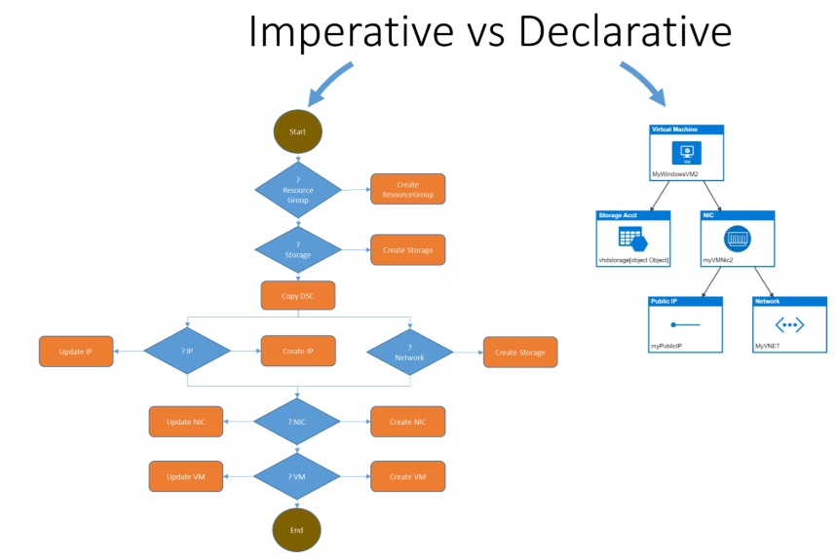
Infrastructure: Imperative vs. Declarative
Imperative
Tell the system HOW to do something – every step of the way
Example: Azure CLI, Azure PowerShell
Declarative
Tell the system WHAT you expect to be the final state, and let the system figure out HOW
Examples: Bicep, ARM, Terraform
Describe Instruction
Describe the Outcome

Slide 6
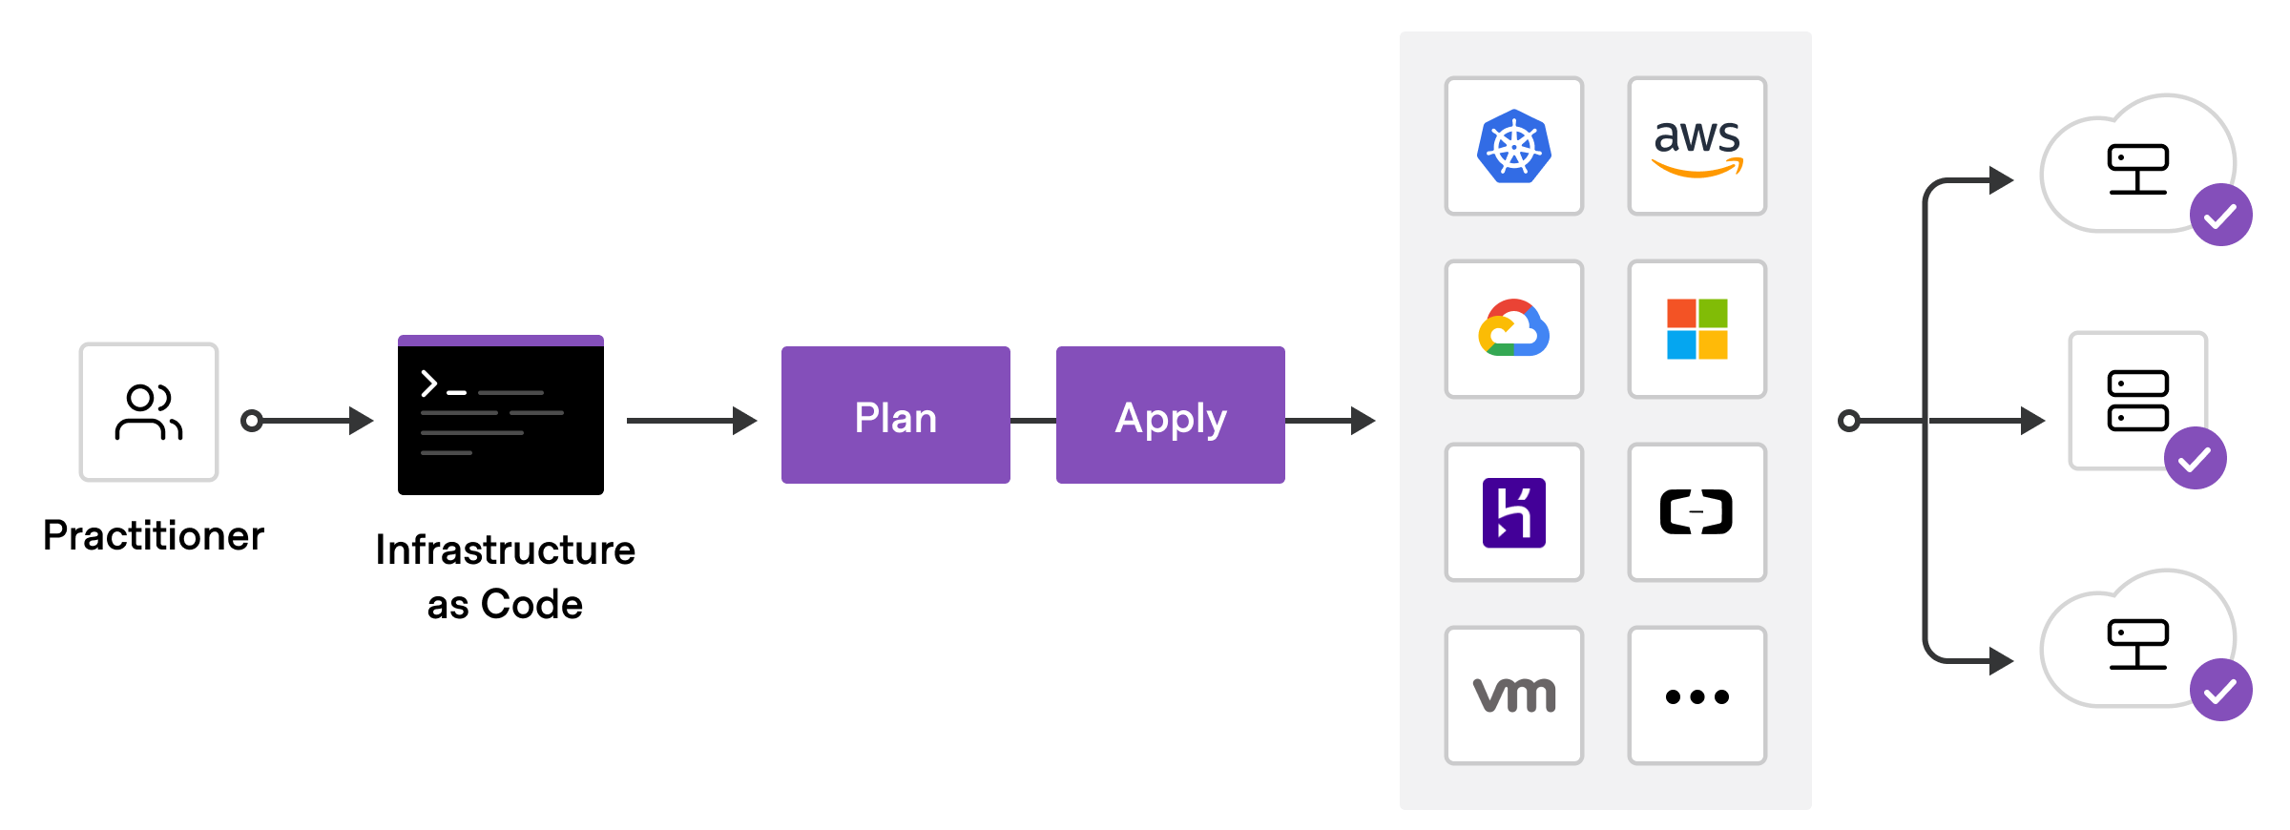
What is Terraform
IT IS
Declarative Language
Infrastructure as code tool
IT IS NOT
Abstraction layer over common cloud provisioning languages
Write once, deploy anywhere
Can manage infrastructure on multiple cloud platforms
Every cloud provider has its own Terraform ‘Provider’
open-source tool developed by Hashicorp

Slide 7
Terraform Terminology
Terraform Provider
Terraform plugins called providers let Terraform interact with cloud platforms and other services via their application programming interfaces (APIs).
Terraform Registry
All providers, module and Hashicorp Policy can be found in Azure Terraform Registry.
Terraform Configuration
A Terraform configuration is a complete document in the Terraform language that tells Terraform how to manage a given collection of infrastructure. A configuration can consist of multiple files and directories.
HashiCorp and the Terraform community have written over 1,000 providers to manage resources on Azure, AWS, GCP, Kubernetes, Helm, GitHub, Splunk and others.
AzureRM is Terraform Azure Provider.
Terraform State
The Terraform state information stores the map of your real-world resources. It stores bindings between objects in the cloud provider and resource instances declared in your configuration. Terraform checks the state data to make decisions on what resources need added or changed.
This state is stored by default in a local file named "terraform.tfstate",
Terraform state can also be stored remotely, which works better in a team environment.

Slide 8
Setting Up Environment
Installation of Terraform
Download Terraform
Install Azure CLI
Install VSCode
VSCode Extensions
Azure CLI tools
Terraform: syntax highlighting, IntelliSense, code navigation, code formatting, module explorer and much more
For more guidance, please refer to this video on YouTube:
Getting started with Terraform and Azure: Overview and Setup - YouTube

Slide 9
Terraform Workflow
The core Terraform workflow has three steps:
Write - Author Configuration Files
Run terraform init to initializes a working directory containing Terraform configuration files and download providers.
Plan - Preview changes before applying.
Apply - Provision reproducible infrastructure.

Slide 10
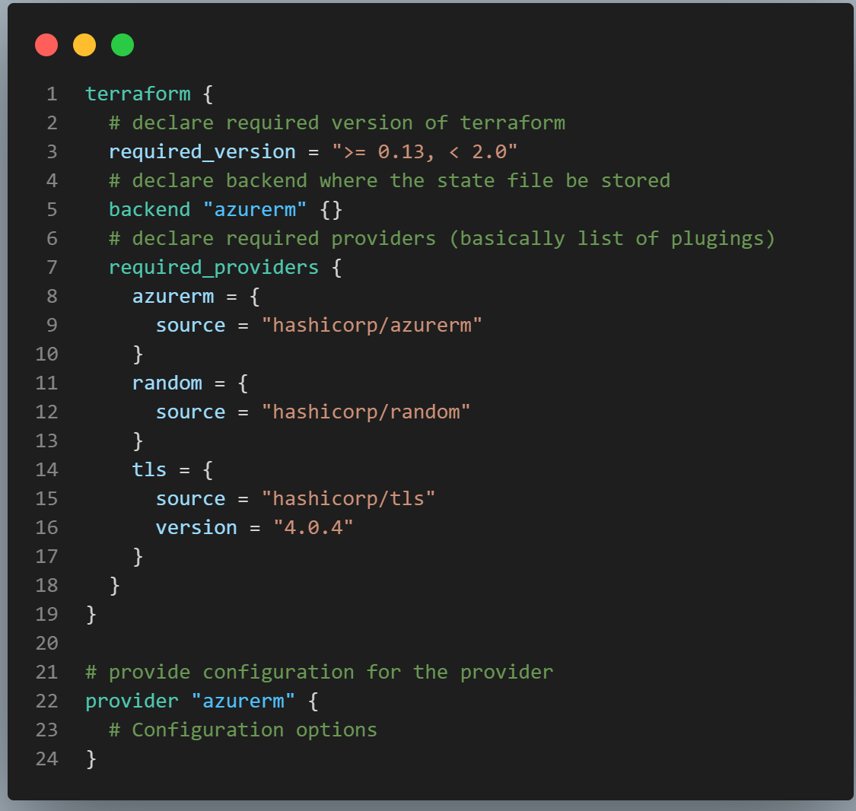
Terraform Configuration File - Providers
The special terraform configuration block type is used to configure some behaviours of Terraform itself, such as requiring a minimum Terrafom version to apply your configuration or the list of providers that are required to run this configuration.
Each provider may also have its own configuration such as list of features it requires or authentication method.

Slide 11
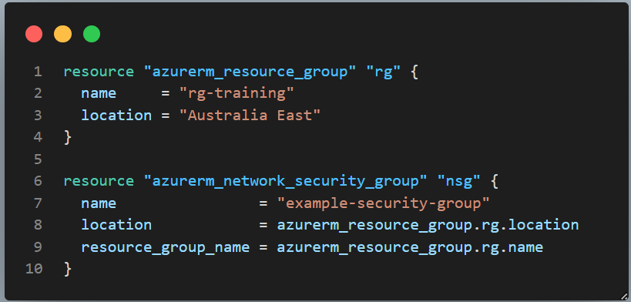
Terraform Configuration File - Resources
Resources are the most important element in the Terraform language. Each resource block describes one or more infrastructure objects, such as virtual networks, compute instances, or higher-level components such as DNS records.
Each Terraform resource has a name that can be referenced in other resources in terraform. In this example ‘rg’.
The name of the Terraform resource may be different from the name of the Azure resource.
When referencing another resource from one resource use terraform name.
See the full list of AzureRM Resources here.

Slide 12
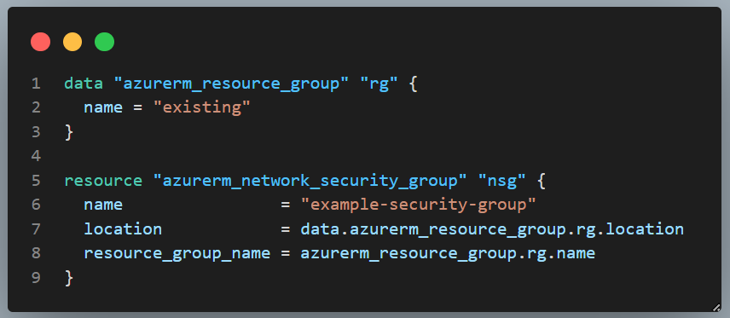
Terraform Configuration File - Data Sources
Data sources allow Terraform to use information defined outside of Terraform, without creating them.
In this example a data block requests that Terraform read from a given data source ("azurerm_resource_group") and export the result under the given local name (“rg").
Other resources can reference attributes of an existing resource.

Slide 13
Terraform authenticating to Azure
Terraform supports several methods for authenticating to Azure:
Authenticating to Azure using the Azure CLI
Authenticating to Azure using Managed Service Identity
Authenticating to Azure using a Service Principal and a Client Certificate
Authenticating to Azure using a Service Principal and a Client Secret
Authenticating to Azure using a Service Principal and Open ID Connect

Slide 14
Demo 1 – Create Resource Group and a VNET
Authenticate to Azure using Azure CLI
Create a main.tf file containing
terraform block,
azurerm provider
a resource group
a vnet

Slide 15
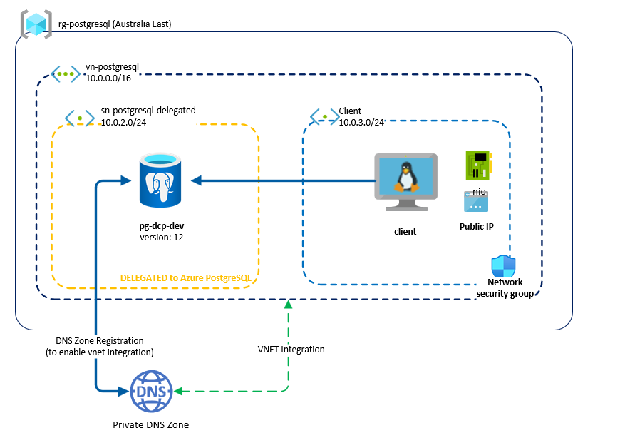
Demo 2 – Create an Azure PostgreSQL Flexible Server
Source: Networking overview - Azure Database for PostgreSQL - Flexible Server | Microsoft Learn

